Slide 1
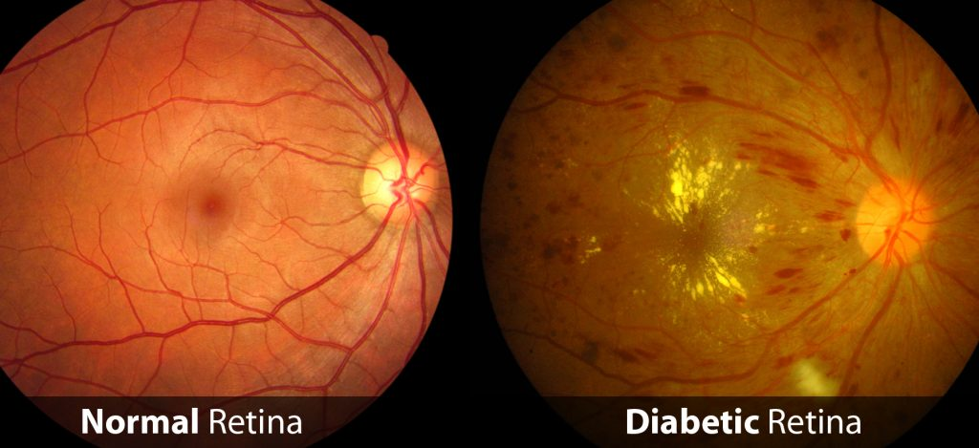
DREAM: Diabetic Retinopathy Analysis
Using Machine Learning
Sohini Roychowdhury, Student Member, IEEE, Dara D. Koozekanani, Member, IEEE,
and Keshab K. Parhi, Fellow, IEEE
IEEE Journal of Biomedical and Health Informatics
GROUP 3
Surabhi S Nath Suril Mehta Vishal Raj Dutta
2016271 2015104 2015115

Slide 2
CONTENTS
Topic Overview - Diabetic Retinopathy
Paper Abstract
Methodology Adopted
Stage 1
Stage 2
Stage 3
Results Obtained
Challenges Faced
Possible Extensions

Slide 3
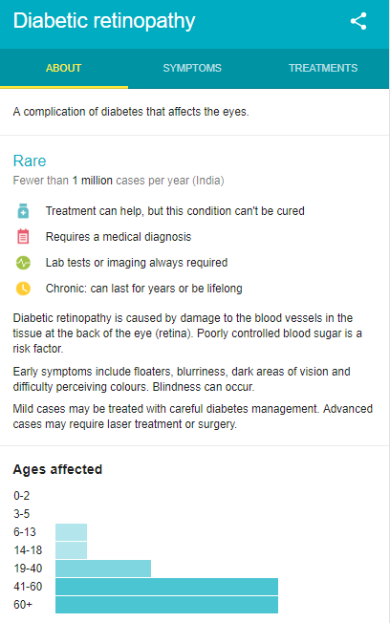
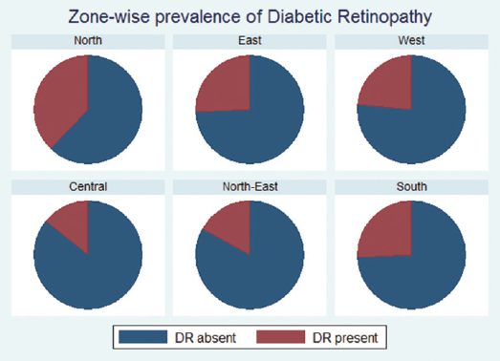
TOPIC OVERVIEW
Overview
Abstract
Methodology
Stage 1
Stage 2
Stage 3
Results
Challenges
Extensions

Slide 4
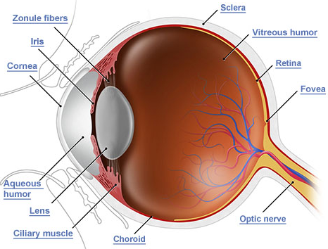
PAPER ABSTRACT
Overview
Abstract
Methodology
Stage 1
Stage 2
Stage 3
Results
Challenges
Extensions
Analyze FUNDUS images
Public datasets
DIARETDB1 - 68 Images, MESSIDOR - 1200 Images
Apply Machine Learning techniques
GMM, kNN, SVM, AdaBoost
Feature Reduction
Two-step Hierarchical Classification
Diabetic Retinopathy Severity Score generation
Beaten the best reported results
Notes:
Analyze FUNDUS images - FUNDUS images are photographs of the back of the eye - ie, the retina region

Slide 5
METHODOLOGY ADOPTED
Remove Background
Optical Disk
Blood Vasculature
Identify Candidate Bright and Red Lesions
Overview
Abstract
Methodology
Stage 1
Stage 2
Stage 3
Results
Challenges
Extensions
Stage 1:
Image Segmentation
Candidate Bright Lesions
Candidate Bright Lesions
Stage 2:
2-Step Hierarchical Lesion Classification
True Bright Lesions
Non Lesions
True Red Lesions
Cotton Wool
Spots
Hard
Exudates
Micro-
aneurysms
Hemorrhages
Stage 3:
Diabetic Retinopathy Severity Grade
GRADE 0 - No Diabetic Retinopathy
GRADE 1 - Mild Diabetic Retinopathy
GRADE 2 - Moderate Diabetic Retinopathy
GRADE 3 - Severe Diabetic Retinopathy

Slide 6
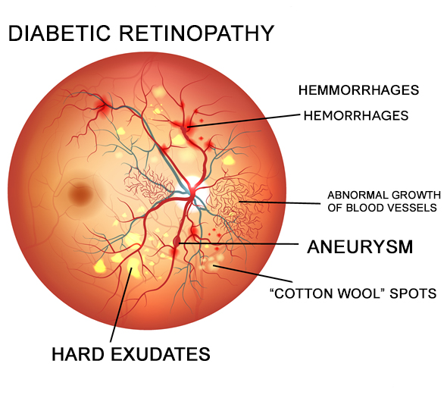

Slide 7
METHODOLOGY - Preprocessing
Overview
Abstract
Methodology
Stage 1
Stage 2
Stage 3
Results
Challenges
Extensions
Green plan I_{green} chosen since maximum contrast
Histogram equalization
Contrast enhancement
Pixel scaling
Sharpness, Illumination enhancement
Laplacian, Gaussian filter
Median filtering

Slide 8
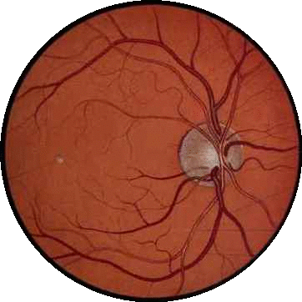

METHODOLOGY - Stage 1
Minimum Intensity, Maximum Solidity Algorithm to detect Optical Disk
Intersection of red and bright regions
Optical Disk has low intensity due to thick blood vessels and high solidity or compactness
Blood Vasculature detected
Gradient smoothening
Shade correction
Extract largest red region
Detect candidate bright and red lesions as foreground
Mathematically:
Overview
Abstract
Methodology
Stage 1
Stage 2
Stage 3
Results
Challenges
Extensions
Blood
Vasculature
Optical
Disk

Slide 9
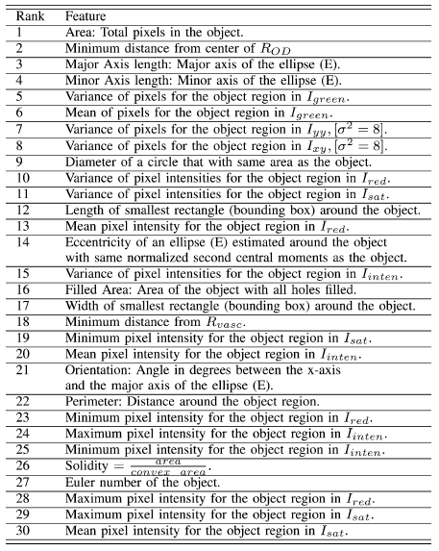
METHODOLOGY - Stage 2
Overview
Abstract
Methodology
Stage 1
Stage 2
Stage 3
Results
Challenges
Extensions
30 features were selected from 78 features using Adaboost
They included 14 structural features and 16 statistical features
GMM, kNN, SVM and their combination were used for hierarchical classification
Trained on DIARETDB1 with 21 images, 68 for internal testing

Slide 10
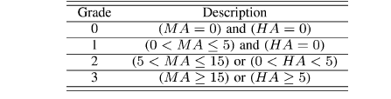
METHODOLOGY - Stage 3
Diabetic Retinopathy Severity Grading
Uses only red lesion numbers - more severe, needs to be more accurately detected
For bright lesions, false positives imply abnormalities other than Diabetic Retinopathy
Must ensure low false positives, high specificity
For red lesions, false negatives will lead to false interpretation of Severity Grade
Must ensure low false negatives, high sensitivity
Overview
Abstract
Methodology
Stage 1
Stage 2
Stage 3
Results
Challenges
Extensions

Slide 11
RESULTS OBTAINED
Overview
Abstract
Methodology
Stage 1
Stage 2
Stage 3
Results
Challenges
Extensions
Results on Internal Dataset - DIARETDB1
Favourable classification of bright vs red lesions
Sensitivity = 95%, Specificity = 90% for Micro-aneurysms vs Hemorrhages
Sensitivity = 99%, Specificity = 97% for Cotton Wool Spots vs Hard Exudates
Higher Specificity for Bright Lesions and higher Sensitivity for Red Lesions, as was desired
Results on External Dataset - MESSIDOR
Sensitivity = 100%, Specificity = 53.16%, AUC = 0.904
Beat state of the art Sensitivity = 96%, Specificity = 51%, AUC = 0.875 and outperformed all existing methods on MESSIDOR

Slide 12
CHALLENGES FACED
Overview
Abstract
Methodology
Stage 1
Stage 2
Stage 3
Results
Challenges
Extensions
Optical disk not blocked
Additional Bright Lesions
Errenuous Image segmentation
Inaccuracies in lesion classification
False detection of Bright Lesions does not affect Severity Score
Cannot conclude accuracy on the basis of Severity Score accuracy
Retinal vein occlusions/degenerated retina
Classified as abnormal though no Diabetic Retinopathy
Unbalanced datasets in Stage 2
Biased classification
Notes:
Retinal vein occlusions - blockage of veins that carry blood away from the retina. Therefore eye looks red.
Degenerated retina - Retina deteriorates due to cell death

Slide 13
POSSIBLE EXTENSIONS
Overview
Abstract
Methodology
Stage 1
Stage 2
Stage 3
Results
Challenges
Extensions
Increase the training data
Apply Neural Networks
Test on multiple datasets

Slide 14
REFERENCES
https://ieeexplore.ieee.org/stamp/stamp.jsp?arnumber=6680633
https://ieeexplore.ieee.org/document/6489310
http://www.ijo.in/article.asp?issn=0301-4738;year=2016;volume=64;issue=1;spage=38;epage=44;aulast=Gadkari
https://www.geographyandyou.com/population/health/expansion-eye-health-services-essential-combating-diabetic-retinopathy/
https://www.google.co.in/search?q=diabetic+retinopathy+india&ei=YLG3W8HCEMLe9QOT-YhI&start=10&sa=N&biw=1517&bih=730
https://drc.bmj.com/content/2/1/e000005

